Slide 1



Rewards and Recognition Programs that Drive Positive Food Safety Culture
October 26, 2022, | Moderators: Conrad Choiniere and Vanessa Coffman

Slide 2


Agenda
Welcome – Donald Prater and Conrad Choiniere (U.S. FDA)
Setting the stage – Lone Jespersen (Cultivate, SA)
Conagra’s Rewards and Recognition Journey – Shawn Fear and Danielle Richardson (Conagra Brands, Inc.)
Q&A – Conrad and Vanessa Coffman (Stop Foodborne Illness)
Closing and next webinar – Conrad and Vanessa
Welcome
Setting the stage
Conagra case study
Q&A
Closing and next webinar

Slide 3




Housekeeping
Everyone will be muted. Please use the Q&A function to ask questions.
You can “up vote” a question. We may not be able to get to all of them.
This event is being recorded and will be posted on the STOP website and YouTube.
You can earn 1 continuing education credit for this webinar, and 1 per webinar moving forward. A form will be attached to a follow-up email.
Welcome
Setting the stage
Conagra case study
Q&A
Closing and next webinar

Slide 4

Welcome
Setting the stage
Conagra case study
Q&A
Closing and next webinar

Slide 5

Reward & Recognize
Lone Jespersen, Ph.D., Cultivate SA
Welcome
Setting the stage
Conagra case study
Q&A
Closing and next webinar

Slide 6
Why?
Welcome
Setting the stage
Conagra case study
Q&A
Closing and next webinar

Slide 7

Good business sense
50%
Higher trust
companies have 50% less turnover than industry peers.
Trust of senior leadership has the biggest influence on culture
82%
of workers recognized in the last month trust their senior leader
compared to 34% of those who have never been recognized
65%
trust senior
leaders
PERFORMANCE = TRUST = RECOGNIZE AND REWARD
Reference: Work Human Institute of Globoforce, 2017
Welcome
Setting the stage
Conagra case study
Q&A
Closing and next webinar

Slide 8
Motivation
Social needs
sense of belonging, love
Safety needs
security, protection
Physiological needs
hunger, thirst
Esteem needs
Self-esteem, recognition status
Self
Actualization
Reference: Abraham Harold Maslow, 1999
Welcome
Setting the stage
Conagra case study
Q&A
Closing and next webinar

Slide 9

Happy chemicals
Oxytocin release
Gratitude spreads
Reference: “Habits of a Happy Brain”, Breuning PhD, 2016
Welcome
Setting the stage
Conagra case study
Q&A
Closing and next webinar

Slide 10
What?
Welcome
Setting the stage
Conagra case study
Q&A
Closing and next webinar

Slide 11
What are you recognizing?
Purpose
Your company's statements about the reasons for food safety
Behaviors
Observable
Consequence
Reward
Timebound
Why?
Recognition
Escalation
Reference: cultivatefoodsafety.com
Welcome
Setting the stage
Conagra case study
Q&A
Closing and next webinar

Slide 12
Store Manager
Purpose
Put the safety of our customers first
Behaviors
Manager discuss food safety performance with everybody in the store monthly
Consequence
Improved performance recognized in monthly post by CEO
Reference: cultivatefoodsafety.com
Welcome
Setting the stage
Conagra case study
Q&A
Closing and next webinar

Slide 13
Production Supervisor
Purpose
Protect the safety of our families and those we serve
Behaviors
Team members found a broken seal. Supervisor stopped the process and led investigation
Consequence
Less product discarded and recognized in the monthly business meeting
Reference: cultivatefoodsafety.com
Welcome
Setting the stage
Conagra case study
Q&A
Closing and next webinar

Slide 14
How?
Welcome
Setting the stage
Conagra case study
Q&A
Closing and next webinar

Slide 15
Pyramid of recognition
Impact
Frequency
Formal
Informal
Everyday
1-10%
Annually
30-50%
Monthly to quarterly
80-100%
Daily to weekly
References: Birchwood Foods, Crawford, 2022; Recognition Professionals International (RPI), 2022.
Welcome
Setting the stage
Conagra case study
Q&A
Closing and next webinar

Slide 16
Tips for tomorrow
Prioritize
Ensure making a change to your R&R program is a priority for all leaders in your company
Analyze
Analyze where you spend your time on the Pyramid of Recognition
Connect
Connect with your colleagues in other functions and see if there is already a program that you can link your food safety R&R activities to.
Reuse
Reuse where you can from other functions
Invent
Invent new tactics with those who will receive recognition to maximize impact and drive pinpointed behaviors against your FS Purpose.
Make
Make it fun!
Welcome
Setting the stage
Conagra case study
Q&A
Closing and next webinar

Slide 17
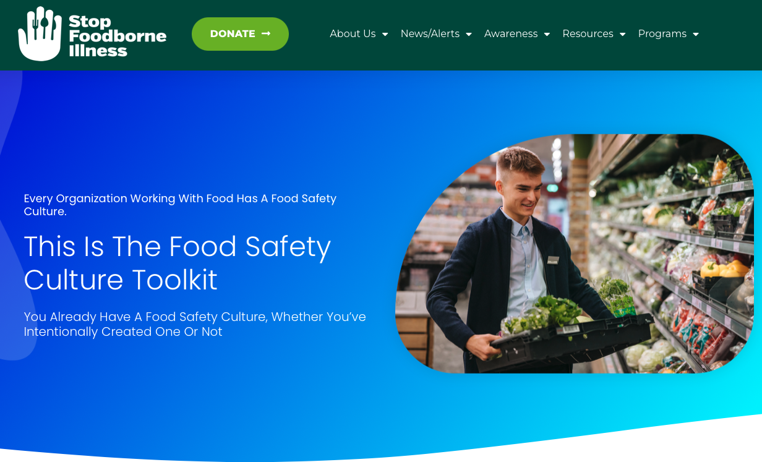
Alliance Toolkit
Reference: https://stopfoodborneillness.org/toolkit/
Welcome
Setting the stage
Conagra case study
Q&A
Closing and next webinar

Slide 18
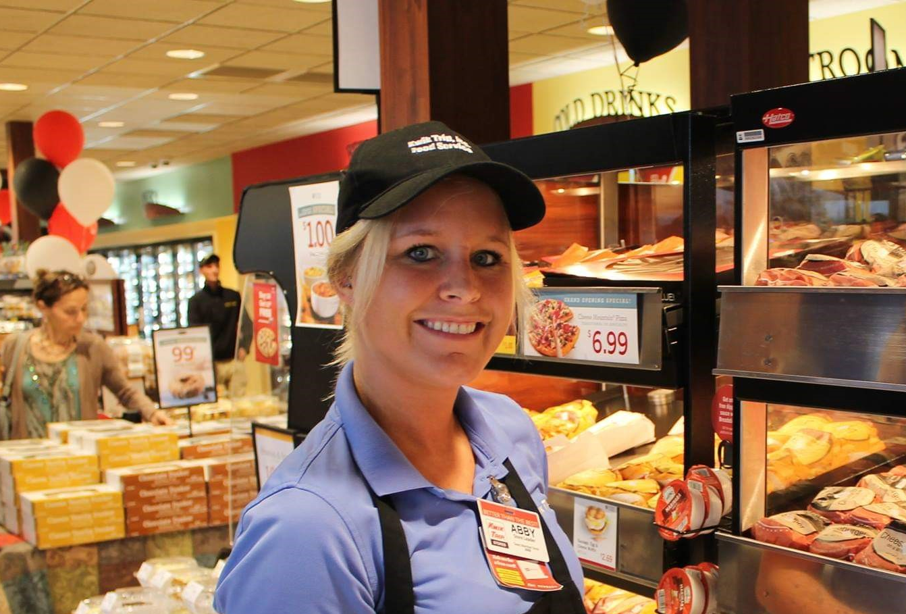
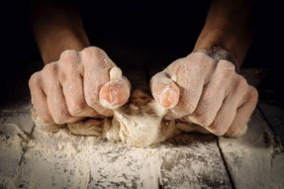
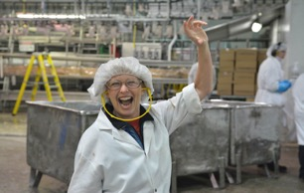
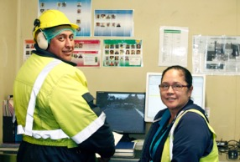
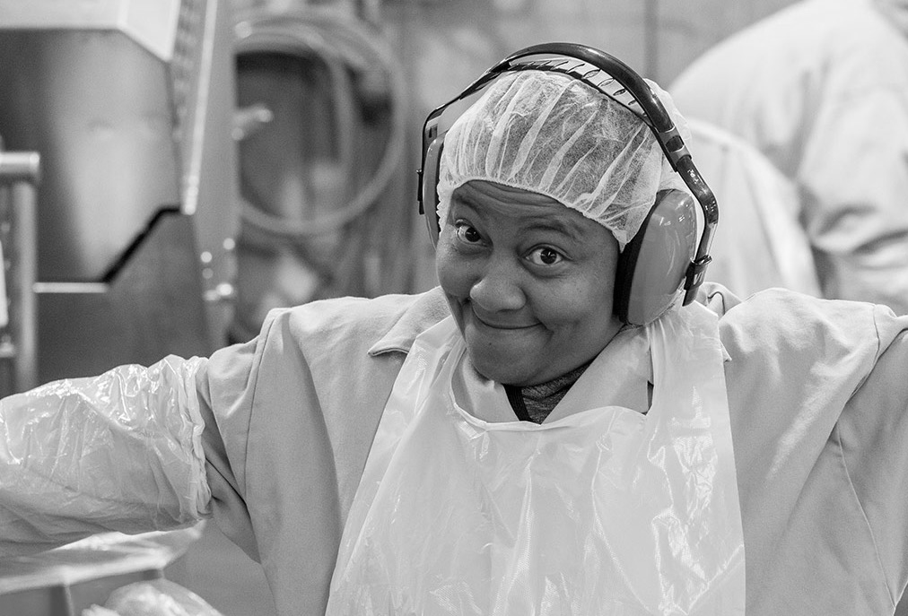
Thank you
Mary, Sausage Packer
Ben and Tara, Shippers
Jenny, Hot Counter
Wayne, EVP, Sales and Marketing
Lone Jespersen, PhD
lone@cultivatefoodsafety.com
+41 79 246 0807
Welcome
Setting the stage
Conagra case study
Q&A
Closing and next webinar

Slide 19

Type your questions into the Q&A window
and up-vote those you would like answered
Welcome
Setting the stage
Conagra case study
Q&A
Closing and next webinar

Slide 20

Webinar #6: Training and Education
Wednesday January 25, 2023 | 12:00pm EST
vcoffman@stopfoodborneillness.org
Welcome
Setting the stage
Conagra case study
Q&A
Closing and next webinar

